Slide 1

UNIT FOUR: WAVES AND SOUND
Introduction to Waves
This lesson will introduce you to waves.
You will also learn about the terminology associated with waves

Slide 2
Learning Goals
By the end of this lesson, you will be able to:
define a wave
explain the different types of waves
label and explain the different parts of a wave

Slide 3
Success Criteria
Can I:
state and explain the definition of a wave
state and explain the two types of waves
draw a fully labelled diagram of each type of wave
identify and explain the parts of a wave

Slide 4
Definition of a Wave
A wave is the transfer of energy through a medium, usually in the form of a disturbance
most waves need a medium to travel through
the undisturbed medium through which the wave travels through is called the equilibrium position.
regions where the medium rises above the equilibrium position are called crests.
regions where the medium is lower than the equilibrium position are called troughs.

Slide 5
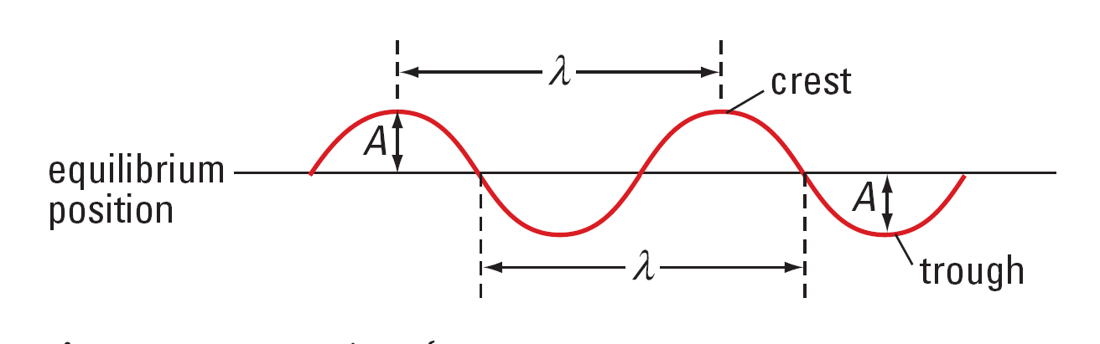
the height of a crest or the depth of a trough is called the amplitude, A, of the wave.
The distance between successive crests or troughs is called the wavelength, λ, of the wave

Slide 6
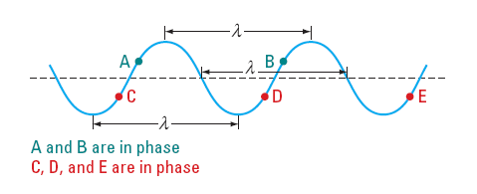
A small part of a wave, either a crest or a trough is
called a wave pulse.
The leading edge of a wave is called the wave front.
A wave that is continuous will have many points that
have the identical motion. These points are said to be
in phase with each other

Slide 7
Types Of Waves
all waves come from a vibrating source
there are two types of waves
transverse waves
longitudinal waves

Slide 8
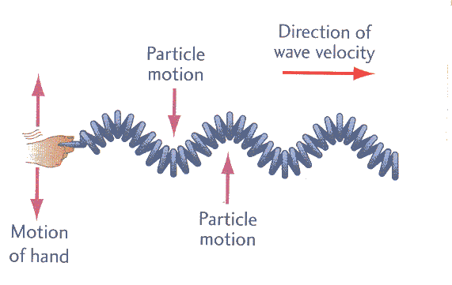
In a transverse wave, the particles in the medium vibrate perpendicular to the direction of wave motion

Slide 9
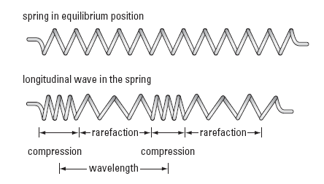
In a longitudinal wave, the particles in the medium vibrate parallel to the direction of wave motion

Slide 10
Period and Frequency
The time required for one complete oscillation is called the period, T, of a wave
period is a time, so the SI units for period are seconds
the period is the time for one cycle of the wave
The number of oscillations that occur per second is called the frequency, f, of the wave
frequency is measured in Hertz, Hz
frequency is related to period by the following eqn:

Slide 11
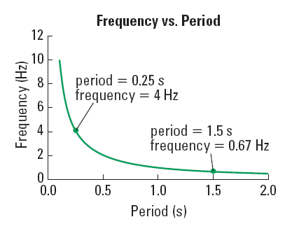

Slide 12
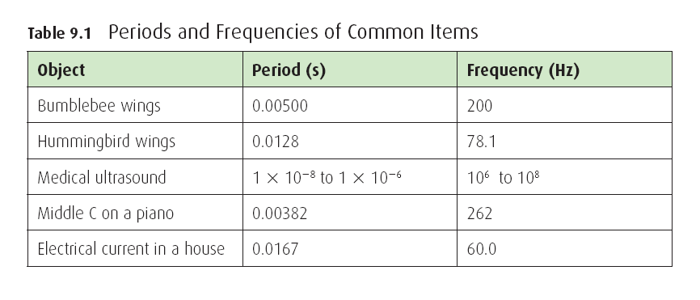
the freq of a wave will be exactly the same as the freq of the source creating the wave.

Slide 13
Sample Problem
You are at the beach and watching waves hit the shore. Every 3.5 seconds a new wave arrives. What are the period and freq of the waves?
Sol’n:
The waves arrive every 3.5 s, so T = 3.5 s.
∴ the freq is 0.29 Hz, and the period is 3.5 s

Slide 14
HOMEWORK
Read Section 8.1 – 8.3
Questions 1 – 4 pg 380
1 – 6 pg 384
1 – 5 pg 387

